Slide 1
Nuts & Bolts for Program Administrators

Slide 2
Overview of Kansas State Board of Nursing

Slide 3
KSBN Mission
The mission of the Board of Nursing is to assure the citizens of Kansas safe and competent practice by nurses and mental health technicians.

Slide 4
Board & Committee Meetings
K.S.A. 74-1106 (authorizing statute)
11-member Board – appointed by the Governor
https://governor.kansas.gov/serving-kansans/office-of-appointments/
Board meets quarterly with committee meetings (committee members appointed by Executive Administrator)
Investigative Committee (9am) meets Monday
Education (8:30am), CNE / IV Therapy (12:30pm), APRN (2pm) and Practice (3pm) committees meet on Tuesday
Finance (8:30am) and full Board (9:15am) meeting on Wednesday

Slide 5
Board & Committee Meetings
Meeting dates are found on KSBN website:
https://ksbn.kansas.gov/board-meetings/
Meeting schedule
Will also find Agendas, minutes and upcoming meeting packets at same location the week prior to the meetings

Slide 6
Board Members
Board Member information is located on KSBN website: https://ksbn.kansas.gov/ and click on the Board tab at top right
Member list
Board meeting schedule
Board packets posted week before meeting

Slide 7
Education Committee
Membership
A minimum of three Board members including at least two Education RNs and four non-Board members
Representing the four types of education programs:
PN
ADN
BSN
APRN

Slide 8
Education Committee
Purpose
To review and recommend revisions in educational statutes and regulations for nursing, APRN, RNA and MHT programs
To review educational policies for nursing and MHT programs
To review all reports, evaluations, and site visit reports for schools of nursing, APRN, RNA and MHT programs

Slide 9
Education Committee
Responsible to do the following:
Approve programs which prepare licensees
Conduct on-site visits to schools of nursing and MHT programs
Review educational policies for all basic programs
Review and recommend approval of petitions to take / retake licensure examinations
Review and recommend approval of major curriculum change requests from programs

Slide 10
Contacts at KSBN
Nursing Program Questions:
Janelle Martin, MHSA, RN – 785-296-5036 or Janelle.martin@ks.gov
Chelsey Stephenson, 785-296-5062 or Chelsey.Stephenson@ks.gov (IV therapy rosters)
Michelle Brown, 785-296-3782 or michelle.brown@ks.gov
Executive Administrator Questions:
Carol Moreland, MSN, RN – 785-296-5752 or carol.moreland@ks.gov
Investigative / Practice Questions:
Linda Davies, BSN, RN – 785-296-8401 or linda.davies@ks.gov

Slide 11
Contacts at KSBN
LPN and RN NCLEX Exam questions:
Karen McGill, 785-296-2453 or karen.mcgill@ks.gov
Licensing Supervisor Questions:
Rae Ann Byrd, 785-296-6573 or raeannbyrd@ks.gov

Slide 12
Kansas Nurse Practice Act
Can be found on KSBN website:
https://ksbn.kansas.gov/npa/
Rules and regulations pertaining to approval / reapproval for schools of nursing
60-1-102 Approval procedures
60-1-103 Discontinuing a school of nursing
60-1-104 Definitions

Slide 13
Kansas Nurse Practice Act
Rules and regulations pertaining to requirements for approved nursing programs:
60-2-101 Requirements for initial approval
60-2-102 Re-approval requirements
60-2-103 Faculty and preceptor qualifications
60-2-104 Curriculum requirements
60-2-105 Clinical resources
60-2-106 Educational facilities
60-2-107 Student policies
60-2-108 Reports

Slide 14
Kansas Nurse Practice Act
Rules and regulations pertaining to advanced nursing education:
60-17-101 Definitions
60-17-102 Requirements of initial approval
60-17-103 Re-approval requirements
60-17-104 Faculty and preceptor qualifications
60-17-105 Curriculum requirements
60-17-106 Clinical resources
60-17-107 Educational facilities
60-17-108 Student policies
60-17-109 Reports

Slide 15
Program Administrator Responsibilities

Slide 16
General Responsibilities
The director and faculty of the program are accountable for complying with the Board rules and the Nursing Practice Act (NPA). One of the responsibilities of the director is to be knowledgeable about the rules and NPA and to ensure that the faculty members are also knowledgeable about the rules and NPA.

Slide 17
Program Approval
K.A.R. 60-2-102 – Program Requirements
Key Program Administrator Responsibilities:
Orientation plan for new faculty (all)
Mentoring plan for new faculty – administrative and teaching responsibilities
Curriculum is current is being evaluated continuously
Testing process in place with testing analysis
Current policies per K.A.R. 60-2-107

Slide 18
Program Approval
Key Program Administrator Responsibilities: (cont’d)
Nursing Faculty Handbook and Nursing Student Handbook are current
Clinical resources K.A.R. 60-2-105
Clinical contracts are current and signed
Observational experiences – no more than 15% of hours for the course
Precepted experiences – no more than 20% of clinical hours of the nursing program (excludes capstone)

Slide 19
Program Approval
Key Program Administrator Responsibilities: (cont’d)
K.A.R. 60-2-103 (2) & (3) Preceptors
Preceptors meet requirements (documented)
Written plan for how preceptors selected
Documented completion of a preceptor orientation
K.A.R. 60-2-104 Curriculum
Direct clinical instruction as an integral part of the program
Didactic content and clinical experience to meet objectives
Oversee development and implementation of a written plan that:
provides evidence of program evaluation and effectiveness, and
is used for ongoing program improvement

Slide 20
Program Site Visits
Each nursing education program in Kansas is surveyed every five to 10 years, in accordance with the KNPA Statutes & Administrative Regulations.
Programs not accredited by a national agency will be visited every five years.
Programs that have national accreditation will be visited with at least the frequency of the accrediting organization.
Nursing program administrators may request that the KSBN survey visit and Accreditation survey visit be done as a joint survey visit for the mutual benefit of all parties.
About six months before the survey visit:
Contacted by the Education Compliance Officer - select a date for site visit
Guidelines for survey visits e-mailed along with blank report
Guidelines available for joint survey visits if desired (crosswalk needed)
All guidelines and blank site visit report templates available on the KSBN website in the Resource section for Program Administrators. (https://ksbn.kansas.gov/administrator-resources/ )

Slide 21
Site Visits Guidelines
30 days prior to site visit - a pre-visit self-study report should be completed and submitted to KSBN Education Compliance Officer
Include a current copy of the parent institution’s catalog or bulletin with the report.
Also include a copies of:
college faculty handbook,
college student handbook, and
nursing program handbooks for faculty and students
Report may be submitted electronically, but a printed copy should be 3-hole punched (binding is not necessary), printed on one side only, and submitted to KSBN office with all required documents and all documents on a USB drive.
Self-Evaluation Report
Pages should be numbered, including any appendices, and
A table of contents should be included for the report.

Slide 22
Site Visits Guidelines
Site survey visit – usually completed in two days; if done in conjunction with accreditation visit then usually 3 days
Sample documents available on website
Agenda
Report outline
List of documents for onsite review or as part of virtual resource room
Curriculum table
Faculty table
Program evaluation plan

Slide 23
Program Evaluation Plan
What should be included:
Evaluation criteria – what components will be evaluated;
Methodology – how the data will be collected;
Frequency of evaluation – when the data will be collected;
Assignment of responsibility – who will be responsible for data collection; and
Indicators of program and instructional effectiveness – benchmarks to be achieved.

Slide 24
Program Evaluation Plan
The steps of the evaluation process should include:
What – select an area to be evaluated. Criteria for evaluation must be measurable and include benchmarks or indicators of success/effectiveness
When – decide on a timeframe for evaluation – Every year? Every semester? Every three years?
Who – appoint an individual or committee to be responsible for the evaluation
How – decide how the evaluation will occur: questionnaires, evaluation forms, committee decision
Benchmark – set a benchmark or goal for success – for example, 90% express satisfaction
Findings – collect the data, collate and analyze it
Outcome – make changes in the evaluation for the next time or continue with same plan. Make revisions to program based upon analysis of data. Document decision-making in the faculty minutes and rationale for decisions

Slide 25
Education Forms
The following education forms can be found on the KSBN website:
Faculty Qualification Report (FQR)
Faculty Degree Plan
Faculty Hire Exception
Major Curriculum Change Request
Minor Curriculum Change Request
Test Before Transcript
https://ksbn.kansas.gov/wp-content/uploads/Forms/Test_Before_Transcript.pdf

Slide 26
Faculty Qualification Report
Faculty Qualification Report or FQR 60-2-103 (c) (1)
Should be submitted when a new faculty member is hired or current faculty member has a change in status
Change in employment status
Completion of degree plan or advanced degree
Requested submission within 30 days of appointment (date hired as faculty) – may submit prior to hire date
Include copies of transcripts for original RN licensure degree and any further education
Copy of approved FQR will be returned to you for your records (in faculty file)
https://ksbn.kansas.gov/administrator-resources/

Slide 27
Faculty Degree Plan
Faculty Degree Plan
If the faculty member does not have the appropriate degree as defined in 60-2-103 and is enrolled in a program to obtain appropriate degree, a faculty degree plan should be submitted
Need an enrollment date and name of program attending
Should reflect planned degree completion within six (6) years of appointment date
Upon completion of the degree, a copy of the transcript showing completion degree and date of completion should be submitted
Notification and rationale for each faculty member not following the submitted degree plan should be sent to KSBN
Should be submitted with an FQR
https://ksbn.kansas.gov/wp-content/uploads/Education/Faculty_Degree_Plan.pdf

Slide 28
Faculty Hire Exception
Faculty Hire Exception form
Should be submitted when a faculty member does not meet criteria as stated in 60-2-103 and is NOT completing education (degree plan) to meet criteria
Hire exception will be reviewed by Education Compliance Officer and approved/ not approved/ deferred to Board
If approved, hire exception expires one year after approval date
When hire exception expires, another hire exception should be submitted if person is retained as faculty (update FQR also required)
No limit to the number of times a hire exception can be renewed at this time

Slide 29
Major Curriculum Change
Should be submitted for the following changes:
Any change in the plan of nursing curriculum organization that involves philosophy, number of semesters of study, or delivery method of a nursing course
Any change in content requiring a change in clock-hours or credit hours in nursing courses
Any change in the number of students to be admitted to the nursing education program (separate form for this)
Must be submitted at least 30 days before a scheduled board meeting with supporting documentation as per directions
https://ksbn.kansas.gov/wp-content/uploads/Education/Major_Curriculum_Changes.pdf

Slide 30
Minor Curriculum Change
Should be submitted for minor curriculum changes that involve:
Content
Course title
Objectives or outcomes
Submitted to Education Compliance Officer for review and approval, denial or deferral to the Board
https://ksbn.kansas.gov/wp-content/uploads/Education/Minor_Curriculum_Change.pdf

Slide 31
IV-Therapy in PN Programs
IV Therapy Regulations – finalized January 2020
KAR 60-16-104
Major Curriculum Change Required PN Program IV Therapy Roster
submitted electronically no earlier than 30 days prior to graduation date
rosters reviewed weekly for new graduates who are licensed
Chelsey Stephenson, 785-296-5062, chelsey.stephenson@ks.gov

Slide 32
IV-Therapy in PN Programs

Slide 33
Initial Application Process
RaeAnn Byrd
Licensing Supervisor

Slide 34
Licensing Division Contacts:
Jackie Mercer
Senior Administrative Assistant Front Desk jackie.mercer@ks.gov 785-296-2967
Barbara Bigger
Senior Administrative Assistant Renewals, Reinstatements Data Records Archives barbara.bigger@ks.gov 785-296-2926
Karen McGill ***
Senior Administrative Assistant LPN and RN Applications/NCLEX karen.mcgill@ks.gov 785-296-2453
RaeAnn Byrd, CPM
Licensing Supervisor Endorsements, Advanced Practice raeann.byrd@ks.gov 785-296-6573

Slide 35
Initial Application Process

Slide 36
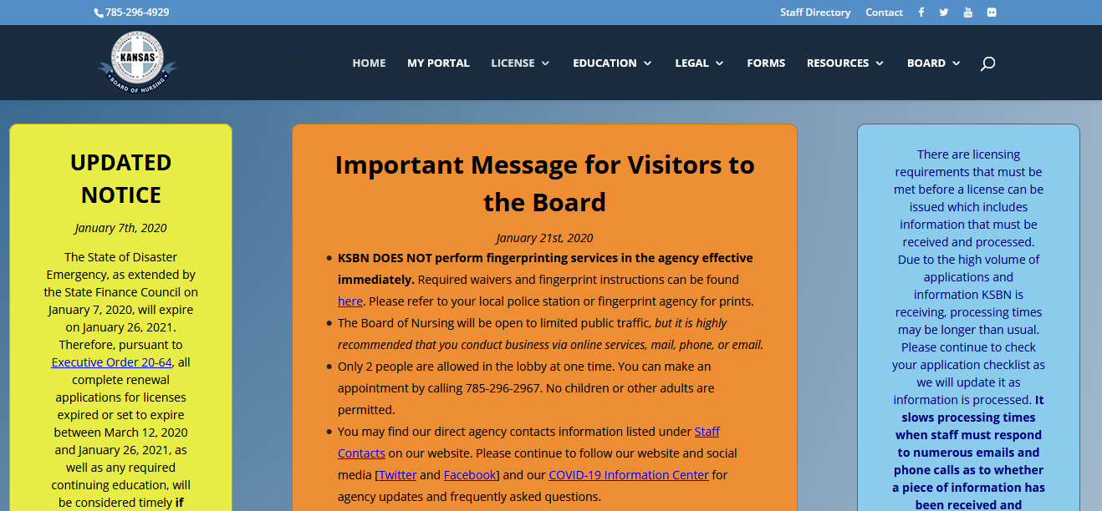
Kansas Board of Nursing website: https://ksbn.kansas.gov/

Slide 37
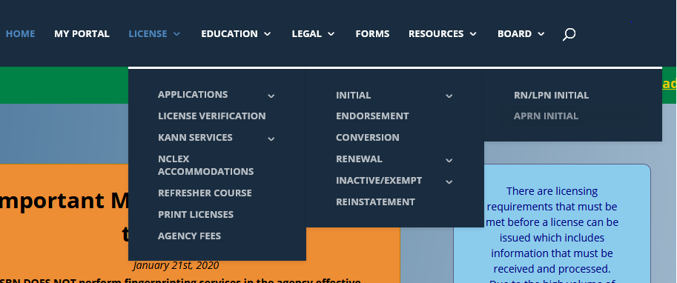
How do I get to the initial application?
Hover over License in the toolbar, then Applications, then Initial, then LPN/RN Initial

Slide 39
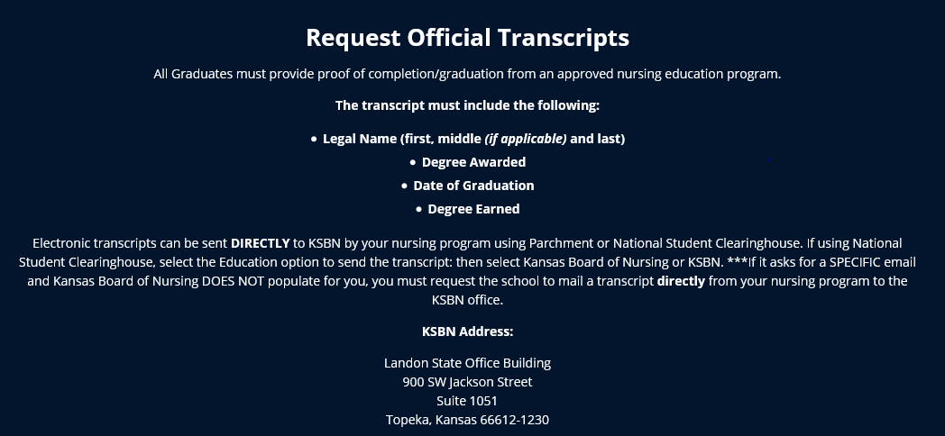
Application Requirements:
1. Transcript

Slide 40
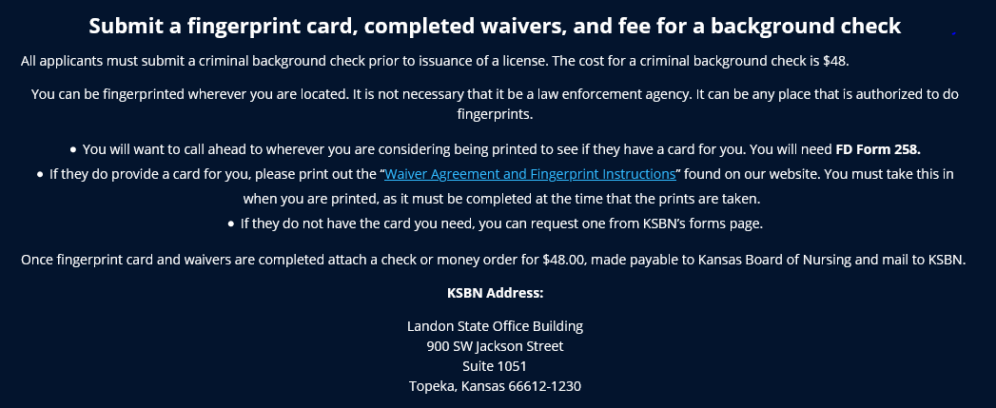

Slide 41
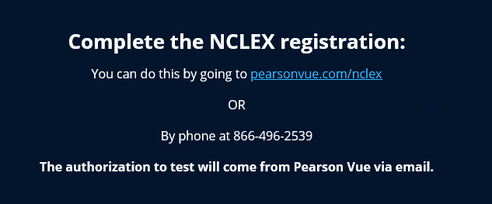

Slide 42
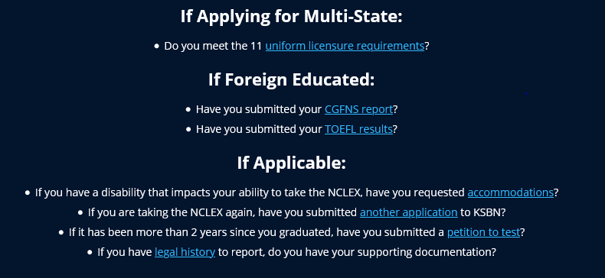

Slide 43
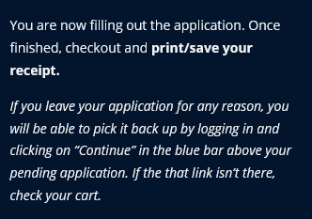
How do I submit the online application?

Slide 44
Multistate vs. Single State
A single state will only allow you to practice in the State of Kansas.
Can apply with any states Drivers license and any states address. Does not have to claim Kansas as Primary state of Residence.
A multistate license will allow to practice in Kansas and other participating compact states.
Must have Kansas Drivers License, Kansas address, and claims Kansas as Primary State of Residence to be eligible and must meet all the Uniform License Requirements

Slide 45
My application is submitted, what now???
Applications are processed within 10 business days of being received and are processed in the order they are received.
Checking your application status can be done by logging into your portal page and clicking “View Checklist” above your pending application. Please allow 7-10 business days to pass before logging in to check the status.
The My Portal tab is in the toolbar on the home page.

Slide 46
In order to test:
KSBN must have received and processed a completed application, received an official transcript with degree and graduation date or the school can send a signed/authorized ATT, and applicant must have paid Pearson Vue.
Applicants will not be made eligible unless these three things are received!
If the school prefers to send ATT’s for student to be eligible the school will put a date on the form that KSBN cannot make you eligible to test until then! Please get with your school regarding the date they choose! An official transcript is still required for licensure!

Slide 47
Test Before Transcript (Approval to Test or ATT)
Form should be completed only by the Dean or Director of the Nursing program and done for each student that they authorize to complete NCLEX before transcript is received by KSBN
Send to Karen McGill in Licensing
Make sure form is filled out completely
Student will NOT be licensed before transcript is received by KSBN (can take 2-3 weeks from school to KSBN!)
https://ksbn.kansas.gov/wp-content/uploads/Forms/Test_Before_Transcript.pdf

Slide 48
I am eligible and have set my test date, now what?..
Pearson Vue results are updated within 3 business days of you taking your test. If you have passed it will show as completed on your checklist. If you have failed it will remain blank and you will receive a letter in the mail with your results.
If you receive a Fail letter: (with an NCLEX Candidate Performance Report)
A new application must be submitted to KSBN
If applying for multistate licensure a new set of fingerprints and fee will need to be submitted. (If submitting for single state licensure the previous prints on file are good for 6 months.)
You will need to re-register with Pearson Vue. You will not be allowed to take the test any sooner than 45 days from the previous test date.
Transcripts are NOT required to be submitted again.

Slide 49
I passed, but where is my license?!!!!
Congratulations!
REMEMBER- Many factors determine licensure!
You can refer to your checklist at any time to see what is still needed! It is updated as we receive requirements!
You may have tested off an ATT, but we have not received an official transcript…
Your application could have gone to legal, and we are still waiting approval…
Or we may still be waiting on the results of your background check.

Slide 50
I have my license!!...but I thought it was valid for two years?!
Kansas renews according to the month and the year that you were born, and depending on when you are licensed, we must get you into the renewal cycle. Everyone’s expiration date is different!
Kansas will not issue a license for less than 6 months which means you may not get a full 2 years the first time the license is issued!
We do not pick people to get longer licensure dates! Be sure to check your expiration date and renew! You will get notice 90 days prior to renewal so be sure to keep the Board up to date with any address or email changes. (You can do this by signing in to the “My Portal” anytime.)

Slide 51
But what about???...
I received a single state- but now want to apply for multistate?
You would need to submit a conversion application and another set of fingerprints for a background check. If you meet the ULR’s you would be eligible for the multistate.
Kansas is not my primary state of residence and I hold another states drivers license, can I still test here and be licensed?
Of course! You would only be eligible for single state here in Kansas unless you changed your drivers license OR you can reach out to your home state and apply for licensure there. (If your home state is a compact state you could use that license here in Kansas once it is issued.)

Slide 52
I am moving to another compact state…what happens to my Kansas multistate?
You can start work on your Kansas multistate license right after moving! But you do need to contact the Board of Nursing in the state that you moved to as you do have to obtain compact licensure through that state. You cannot hold two compact licenses and once you change your primary state of residence you must change your license.
I have a Kansas single state license and am moving to another state that is not compact…what happens to my license?
Nothing! If you continue to renew, your Kansas license will be active, but you cannot use that license to work in another state. If you choose not to renew the license will go into a lapsed status. You would need to contact the Board of nursing in the state that you moved too, to obtain licensure in that state.

Slide 53
That was a lot of information!
Please reach out if there are any questions!
RaeAnn Byrd, CPM
Kansas Board of Nursing
785-296-6573
Raeann.byrd@ks.gov

Slide 54
Helpful Hints for Graduates
Submit KSBN Application + Fingerprints at same time (fingerprints need to be tied to an application)
Pay all Fees
If there is a KNOWN legal history – address sooner, not later

Slide 55
Applications with Legal History
Having been convicted of a misdemeanor or felony will cause the application to receive a legal review
This will occur for an answer of YES on the application for any legal question and/or the background check reveals a conviction.
Documents must be received from the applicant before the application will be presented for decision
Certified dated court documents for any conviction must be received.
An Explanatory Letter by the applicant must be received.
KSBN does not give legal advice nor will look at a background prior to an application for licensure

Slide 56
Most Common Application Errors
“Monitoring” question – “Are you currently participating in a monitoring program approved by a licensing board?”
The only monitoring program approved by KSBN is the Kansas Nurse Assistance Program (KNAP) which works with licensees who have a chemical dependency and/or mental health condition.
Please use a computer (not phone) to complete a licensing application.
Do not assume that once you submit certified dated court documents to a regulatory agency that you can always request them back. It is the nurse’s responsibility to maintain their own documents.

Slide 57
Accommodations for NCLEX Testing
Information is on KSBN website: https://ksbn.kansas.gov/nclex-accommodations/
Documentation must be submitted to KSBN within 15 calendar days of the initial license application being submitted
Investigative area reviews Accommodation requests

Slide 58
Accommodations for NCLEX Testing
A candidate requesting accommodations should NOT schedule an appointment to take the NCLEX until after they have received written confirmation from KSBN of their accommodation and their ATT email indicating “Accommodations Granted”
Candidates approved for testing with accommodation MUST schedule their testing appointment through the NCLEX Accommodations Coordinator by calling Pearson Vue NCLEX Candidate Services at the phone number listed on their Authorization to Test (ATT) email
Candidates with accommodation may NOT schedule their appointments through the NCLEX candidate website

Slide 59
Petitioning for Permission to Retest
When it has been more than two (24 months) years and less than five (5) years after graduation, a graduate must petition the Board for permission to take /retake the NCLEX
After five (5) years from graduation, must retake a nursing program to retest
Petition information available on KSBN website: https://ksbn.kansas.gov/wp-content/uploads/Forms/PETITION-FOR-EXAMINATION-TEST-OR-RETEST.pdf

Slide 60
Petitioning for Permission to Retest
Conditions can be applied to the petition at time of Board approval:
Additional study plan hours
Clinical observation hours that must be completed and verified by RN mentor
Successful completion of a formal NCLEX review course with a predictability score (certificate must have date of completion)
must be within 6 months of petition completion
Auditing nursing courses (pertaining to areas not passed)

Slide 61
Mountain Measurements, Inc.
https://reports.mountainmeasurement.com/nclex/faq

Slide 62
Annual Reports

Slide 63
Annual Report
Discussed in 60-2-108 and 60-17-109
To be submitted on or before JUNE 30th each year
Submitted electronically (new report process with NCSBN starting in 2021)
– no secure log-in required
Information sessions held in the spring of each year to review and discuss report and completion guidelines

Slide 64
Annual Report
New Annual Report
NCSBN Core Data section
2021 – had section for COVID-19 for Spring 2020 and a separate one for Fall 2020
Additional questions section – KSBN required information (based on regulations and USDOE requirements)

Slide 65
Annual Report
Additional questions section (cont’d):
Changes in program policies, organizing curriculum framework, objectives or outcomes, and major and minor curriculum changes
Faculty responsibilities for required and elective nursing courses
Name, license number, academic credentials, employment date, and full or part-time status of each faculty member
The nursing administrator’s assigned teaching responsibilities
For each preceptor, the name, license number, academic credentials, current clinical area of practice, and place where currently employed
For each affiliating clinical agency, the following information:
Name
Location
Student-faculty clinical ratio for the reporting period (what do they allow at the facility)

Slide 66
Annual Report
Statistics for generic, articulation, and transfer students, including the following:
Admissions, readmissions, withdrawals and graduates
First time pass rate for each of the last five years
Faculty statistics, including name, number, credentials, and degree plans and hire exceptions
Budget spent for library and audiovisual acquisitions to support the nursing program for the most recent year

Slide 67
Annual Report
Required to attach:
An audited fiscal report covering the previous two years, including a statement of income and expenditures (USB) – if two separate reports you must put both into a zip file before attaching
A copy of the school’s current catalog

Slide 68
Annual Report
If the nursing education program fails to meet the requirements of the Board or to submit required reports within a designated period of time, the program shall be removed from the list of approved nursing education programs after receiving notice and given an opportunity to be heard

Slide 69
Other KSBN Education Resources
Link to Resources for Administrators under the Education tab: https://ksbn.kansas.gov/administrator-resources/
ADN Nursing Program Alignment – contains information about the ADN program alignment
PN Core Curriculum – last update 2018
Legal Issues Reference Packet

Slide 70
Other KSBN Education Resources
Council for Nursing Articulation in Kansas (CNAK) report
Contains information about the statewide nursing articulation plan for academic progression
Simulation Scenario Library
Simulation scenarios utilized in programs and submitted for posting on KSBN website
May be utilized in your program

Slide 71
Other Education Resources:
Education > Programs
Multi-Year Pass Rates: https://ksbn.kansas.gov/programs/
Lists multi-year pass rates for each of the pre-licensure nursing programs in Kansas – updated every March
Resources > Administrative Resources
Annual Report from KSBN – information about each nursing program: https://ksbn.kansas.gov/annual-report/
KSBN Strategic Plan
KSBN Articles

Slide 72
Nursing Education Councils

Slide 73
Kansas Council for Collaboration in Nursing (KCCN)
Nursing directors that meet to ensure quality education and collaboration around the state of Kansas
Kansas Association of Colleges of Nursing (KACN)
Kansas Council of Associate Degree Nursing Educators (KCADNE)
Kansas Council of Practical Nursing Educators (KCPNE)

Slide 74
KACN
Council for Bachelor’s and Graduate/Post-Graduate Nursing Programs
Chair of KACN:
Geri Tyrell, DNP, RN
Nursing Program Administrator, Bethel College
(316) 284-5286
gtyrell@bethelks.edu

Slide 75
KCADNE
Council of Associate Degree Nursing Programs
President of KCADNE:
Karen LaMartina, PhD, RN
Director of ADN Program, Johnson County Community College
(913) 469-8500 X3175
lamartin@jccc.edu

Slide 76
KCPNE
Council of Practical Nursing Programs
President of KCPNE:
Christina Rudacille, MSN, RN
Director of PN Program, Johnson County Community College
(913) 469-8500 X4767
crudacil@jccc.edu

Slide 77
KSBN Education Contacts
Janelle Martin, MHSA, RN - Education Compliance Officer
785-296-5036
Janelle.martin@ks.gov
Chelsey Stephenson – CNE Education Specialist / IV Therapy
785-296-5062
Chelsey.Stephenson@ks.gov
Michelle Brown - Senior Administrative Asst. - Education
785-296-3782
michelle.brown@ks.gov

Slide 78
WRAP UP
QUESTIONS????

