Slide 1
Program Administrator Update
September 13, 2021

Slide 2
Education Contacts at KSBN
Nursing Program Questions:
Janelle Martin, MHSA, RN – 785-296-5036
or Janelle.martin@ks.gov
Michelle Brown, 785-296-3782 or michelle.brown@ks.gov
Chelsey Stephenson, 785-296-5062
or Chelsey.Stephenson@ks.gov (IV Therapy rosters)

Slide 3
Other Contacts at KSBN
Licensing Supervisor Questions:
Rae Ann Byrd, 785-296-6573 or raeannbyrd@ks.gov
Investigative Process / Practice Questions:
Linda Davies, BSN, RN – 785-296-8401 or linda.davies@ks.gov
Executive Administrator Questions:
Carol Moreland, MSN, RN – 785-296-5752 or carol.moreland@ks.gov

Slide 4
KSBN Mission
The mission of the Board of Nursing is to assure the citizens of Kansas safe and competent practice by nurses and mental health technicians.

Slide 5
Executive Administrator Updates
KSBN Staff Changes
KSBN Update
NLC Update
Education Regulations – Status

Slide 6
Initial Application Process
RaeAnn Byrd
Licensing Supervisor

Slide 7
Licensing Division Contacts:
Jackie Mercer
Senior Administrative Assistant Front Desk jackie.mercer@ks.gov 785-296-2967
Barbara Bigger
Senior Administrative Assistant Renewals, Reinstatements Data Records Archives barbara.bigger@ks.gov 785-296-2926
Karen McGill ***
Senior Administrative Assistant LPN and RN Applications/NCLEX karen.mcgill@ks.gov 785-296-2453
RaeAnn Byrd, CPM
Licensing Supervisor Endorsements, Advanced Practice raeann.byrd@ks.gov 785-296-6573

Slide 8
Initial Application Process

Slide 9
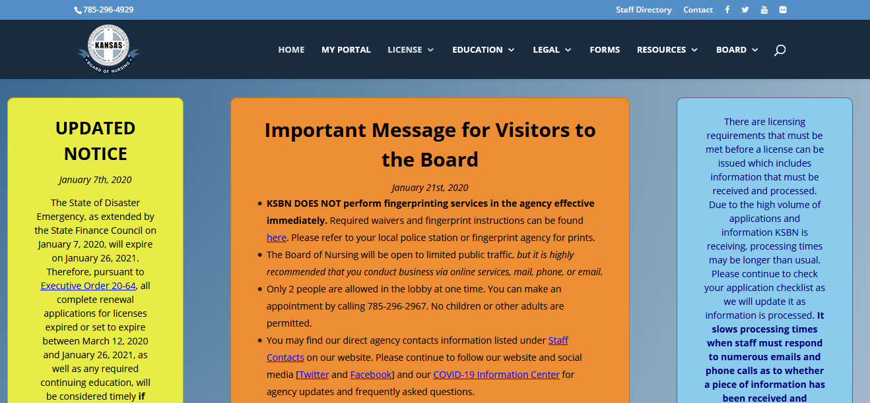
Kansas Board of Nursing website: https://ksbn.kansas.gov/

Slide 10
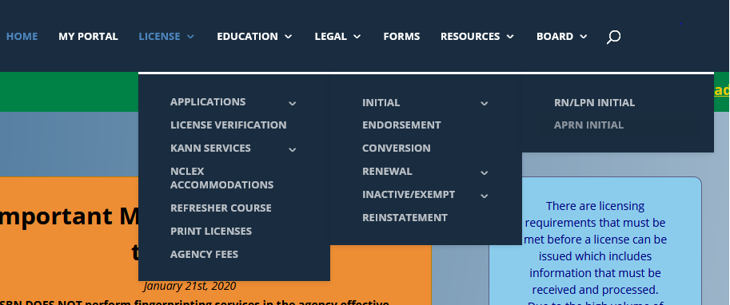
How do I get to the initial application?
Hover over License in the toolbar, then Applications, then Initial, then LPN/RN Initial

Slide 12
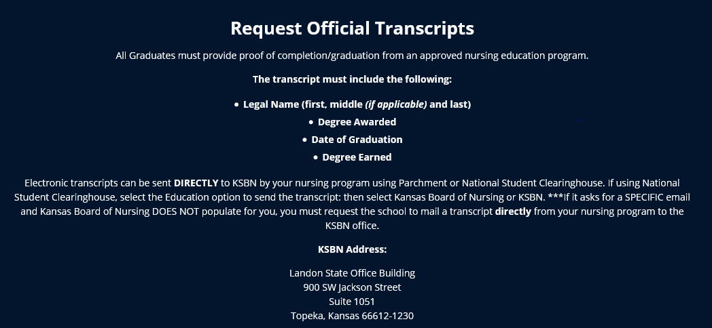
Application Requirements:
1. Transcript

Slide 13
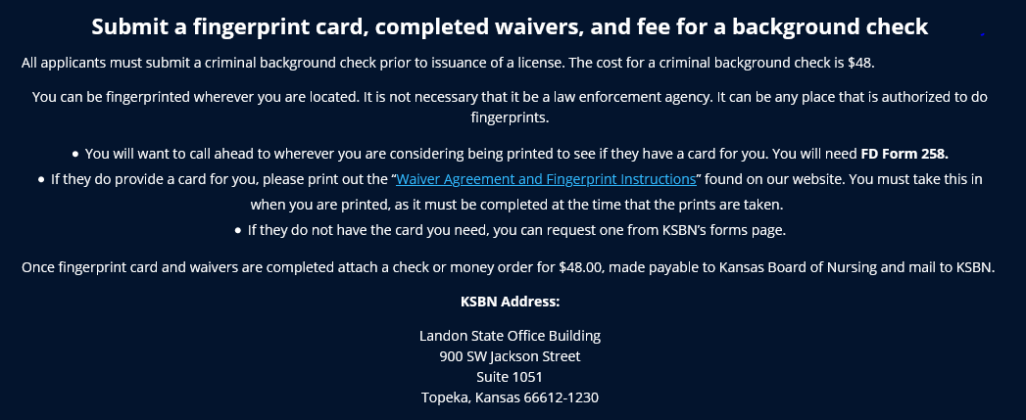

Slide 14
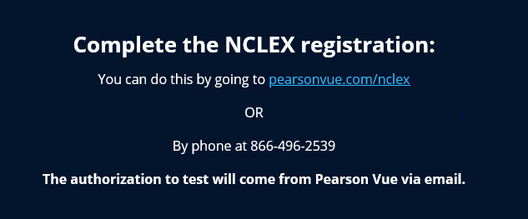

Slide 15
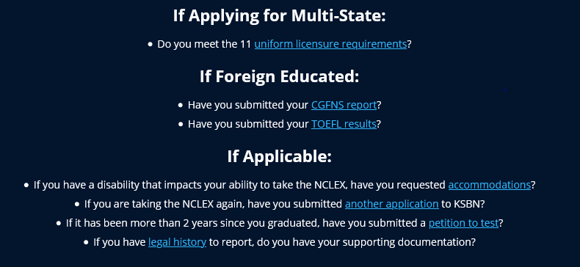

Slide 16
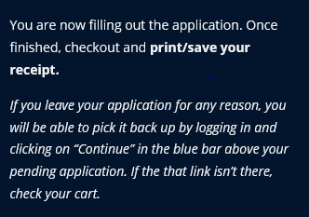
How do I submit the online application?

Slide 17
Multistate vs. Single State
A single state will only allow you to practice in the State of Kansas.
Can apply with any states Drivers license and any states address. Does not have to claim Kansas as Primary state of Residence.
A multistate license will allow to practice in Kansas and other participating compact states.
Must have Kansas Drivers License, Kansas address, and claims Kansas as Primary State of Residence to be eligible and must meet all the Uniform License Requirements

Slide 18
My application is submitted, what now???
Applications are processed within 10 business days of being received and are processed in the order they are received.
Checking your application status can be done by logging into your portal page and clicking “View Checklist” above your pending application. Please allow 7-10 business days to pass before logging in to check the status.
The My Portal tab is in the toolbar on the home page.

Slide 19
In order to test:
KSBN must have received and processed a completed application, received an official transcript with degree and graduation date or the school can send a signed/authorized ATT, and applicant must have paid Pearson Vue.
Applicants will not be made eligible unless these three things are received!
If the school prefers to send ATT’s for student to be eligible the school will put a date on the form that KSBN cannot make you eligible to test until then! Please get with your school regarding the date they choose! An official transcript is still required for licensure!

Slide 20
Test Before Transcript (Approval to Test or ATT)
Form should be completed only by the Dean or Director of the Nursing program and done for each student that they authorize to complete NCLEX before transcript is received by KSBN
Send to Karen McGill in Licensing
Make sure form is filled out completely
Student will NOT be licensed before transcript is received by KSBN (can take 2-3 weeks from school to KSBN!)
https://ksbn.kansas.gov/wp-content/uploads/Forms/Test_Before_Transcript.pdf

Slide 21
I am eligible and have set my test date, now what?..
Pearson Vue results are updated within 3 business days of you taking your test. If you have passed it will show as completed on your checklist. If you have failed it will remain blank and you will receive a letter in the mail with your results.
If you receive a Fail letter: (with an NCLEX Candidate Performance Report)
A new application must be submitted to KSBN
If applying for multistate licensure a new set of fingerprints and fee will need to be submitted. (If submitting for single state licensure the previous prints on file are good for 6 months.)
You will need to re-register with Pearson Vue. You will not be allowed to take the test any sooner than 45 days from the previous test date.
Transcripts are NOT required to be submitted again.

Slide 22
I passed, but where is my license?!!!!
Congratulations!
REMEMBER- Many factors determine licensure!
You can refer to your checklist at any time to see what is still needed! It is updated as we receive requirements!
You may have tested off an ATT, but we have not received an official transcript…
Your application could have gone to legal, and we are still waiting approval…
Or we may still be waiting on the results of your background check.

Slide 23
I have my license!!...but I thought it was valid for two years?!
Kansas renews according to the month and the year that you were born, and depending on when you are licensed, we must get you into the renewal cycle. Everyone’s expiration date is different!
Kansas will not issue a license for less than 6 months which means you may not get a full 2 years the first time the license is issued!
We do not pick people to get longer licensure dates! Be sure to check your expiration date and renew! You will get notice 90 days prior to renewal so be sure to keep the Board up to date with any address or email changes. (You can do this by signing in to the “My Portal” anytime.)

Slide 24
But what about???...
I received a single state- but now want to apply for multistate?
You would need to submit a conversion application and another set of fingerprints for a background check. If you meet the ULR’s you would be eligible for the multistate.
Kansas is not my primary state of residence and I hold another states drivers license, can I still test here and be licensed?
Of course! You would only be eligible for single state here in Kansas unless you changed your drivers license OR you can reach out to your home state and apply for licensure there. (If your home state is a compact state you could use that license here in Kansas once it is issued.)

Slide 25
I am moving to another compact state…what happens to my Kansas multistate?
You can start work on your Kansas multistate license right after moving! But you do need to contact the Board of Nursing in the state that you moved to as you do have to obtain compact licensure through that state. You cannot hold two compact licenses and once you change your primary state of residence you must change your license.
I have a Kansas single state license and am moving to another state that is not compact…what happens to my license?
Nothing! If you continue to renew, your Kansas license will be active, but you cannot use that license to work in another state. If you choose not to renew the license will go into a lapsed status. You would need to contact the Board of nursing in the state that you moved too, to obtain licensure in that state.

Slide 26
That was a lot of information!
Please reach out if there are any questions!
RaeAnn Byrd, CPM
Kansas Board of Nursing
785-296-6573
Raeann.byrd@ks.gov

Slide 27
Test Before Transcript (Approval to Test)
Form should be completed only by the Dean or Director of the Nursing program and done for each student that they authorize to complete NCLEX before transcript is received by KSBN
Student will NOT be licensed before transcript is received by KSBN (can take 2-3 weeks from school to KSBN!)
https://ksbn.kansas.gov/wp-content/uploads/Forms/Test_Before_Transcript.pdf

Slide 28
Applications with Legal History
Having been convicted of a misdemeanor or felony will cause the application to receive a legal review
This will occur for an answer of YES on the application for any legal question and/or the background check reveals a conviction.
Documents must be received from the applicant before the application will be presented for decision
Certified dated court documents for any conviction must be received.
An Explanatory Letter by the applicant must be received.
KSBN does not give legal advice nor will look at a background prior to an application for licensure

Slide 29
Most Common Application Errors
“Monitoring” question – “Are you currently participating in a monitoring program approved by a licensing board?”
The only monitoring program approved by KSBN is the Kansas Nurse Assistance Program (KNAP) which works with licensees who have a chemical dependency and/or mental health condition.
Please use a computer (not phone) to complete a licensing application.
Do not assume that once you submit certified dated court documents to a regulatory agency that you can always request them back. It is the nurse’s responsibility to maintain their own documents.

Slide 30
NCLEX Reminders
Program Report Codes – on quarterly NCLEX reports
Multi-Year Pass Rates: https://ksbn.kansas.gov/programs/
Lists multi-year pass rates for each of the pre-licensure nursing programs in Kansas
Reviewed by Board for Calendar Year – approved at March meeting and updated annually after approval

Slide 31
IV-Therapy in PN Programs
IV Therapy Regulations – finalized January 2020
KAR 60-16-104
Major Curriculum Change Required PN Program IV Therapy Roster
submitted electronically no earlier than 30 days prior to graduation date
rosters reviewed weekly for new graduates who are licensed
Chelsey Stephenson, 785-296-5062, chelsey.stephenson@ks.gov

Slide 32
IV-Therapy in PN Programs

Slide 33
Faculty Qualification Report
Faculty Qualification Report or FQR
Should be submitted when a new faculty member is hired or current faculty member has a change in status
Submit within 30 days of appointment (date hired as faculty)
Include copies of original transcripts for initial RN licensure degree and any further education
Copy of approved FQR will be returned to you for your records (in faculty file)
https://ksbn.kansas.gov/fqr_instructions/

Slide 34
Faculty Degree Plan
Faculty Degree Plan
If the faculty member does not have the appropriate degree as defined in 60-2-103 and is enrolled in a program to obtain appropriate degree, a faculty degree plan should be submitted
Need an enrollment date and name of program attending
Should reflect planned degree completion within six (6) years of appt. date
Upon completion of the degree, a copy of the transcript showing completion of degree and date of completion should be submitted
Notification and rationale for each faculty member not following the submitted degree plan should be sent to KSBN
Should be submitted with an FQR
https://ksbn.kansas.gov/faculty_degree_plan/

Slide 35
Faculty Hire Exception
Faculty Hire Exception form
Should be submitted when a faculty member does not meet criteria as stated in 60-2-103
Hire exception will be reviewed by Education Compliance Officer and approved/ not approved/ deferred to Board
If approved, hire exception expires one year after approval date
When hire exception expires, another hire exception can be submitted if person is retained as faculty
No limit to the number of times a hire exception can be renewed
https://ksbn.kansas.gov/faculty_hire_exception/

Slide 36
Major Curriculum Change
Should be submitted for the following changes:
Any change in the plan of nursing curriculum organization that involves philosophy, number of semesters of study, or delivery method of a nursing course
Any change in content requiring a change in clock-hours or credit hours in nursing courses
Any change in the number of students to be admitted to the nursing education program – requires a separate form
Must be submitted at least 30 days before a scheduled board meeting with supporting documentation as per directions
https://ksbn.kansas.gov/wp-content/uploads/Education/Major_Curriculum_Changes.pdf

Slide 37
Minor Curriculum Change
Should be submitted for minor curriculum changes that involve:
Content
Course title
Objectives or outcomes
Submitted to Education Compliance Officer for review and approval, denial or deferral to the Board
https://ksbn.kansas.gov/wp-content/uploads/Education/Minor_Curriculum_Change.pdf

Slide 38
Site Survey Visits
Decision whether to do virtual or in-person site visits will continue to be made by the Board quarterly
Virtual site visits require virtual resource room
Combined site visits with accreditation teams require a crosswalk to be done for KSBN documentation

Slide 39
Annual Report
Discussed in 60-2-108 and 60-17-109
To be submitted on or before JUNE 30th each year
New annual report process beginning 2021 – working with NCSBN on gathering Core Data
NO secure log-in required
Information sessions are held in the spring of each year to review and discuss report and completion guidelines

Slide 40
Other KSBN Education Resources
Link to Resources for Administrators under the Education tab: https://ksbn.kansas.gov/administrator-resources/
ADN Nursing Program Alignment – contains information about the ADN program alignment
PN Core Curriculum – last update 2018
Legal Issues Reference Packet – being revised

Slide 41
Other Education Resources:
Education > Programs
Multi-Year Pass Rates: https://ksbn.kansas.gov/programs/
Lists multi-year pass rates for each of the pre-licensure nursing programs in Kansas
Resources > Administrative Resources
Annual Report from KSBN – information about each nursing program: https://ksbn.kansas.gov/annual-report/
KSBN Strategic Plan
KSBN Articles

