Slide 1
Informational Session for Annual Reports
Audience: Kansas Nursing Program Administrators
Presenters: Adrian Guerrero, COO, KSBN
Janelle Martin, NECO, KSBN
Guests: Qiana McIntosh, NCSBN
Josephine Silvestre, NCSBN
Notes:
We would like to provide you with an orientation for the annual report that we’ll be sending you this year. It is a little different from previous ones because we are collaborating with NCSBN to create the first ever national nursing education database. Many BONs are participating, and each year NCSBN will release an aggregate statistical analysis of the results. The NCSBN Regulatory Guidelines will be updated accordingly. This is very exciting for nursing!

Slide 2
Background
Evidence
Based
Approval
Lit
Review
Delphi
5-year
Annual
reports
5-year
Site visits
Notes:
Let’s begin by talking about the background to this new annual report process. In July 2020 NCSBN released some evidence-based nursing education approval guidelines (quality indicators and warning signs) for BONs, which are based on 4 separate studies: An integrative literature review, a national Delphi, an analysis of 5 years of 43 BONs’ annual reports and an analysis of 31 BONs’ site visit reports. Not all BONs make site visits, so that has a smaller number participating. The Annual report study was a quantitative study, looking at numbers of students, faculty, etc. The Site visit study was a qualitative study or basically the stories of the programs. The national Delphi was completed by 295 experts in nursing education, regulation and nurses who work with new graduates. That really gave us a diversity of input into the guidelines.

Slide 3
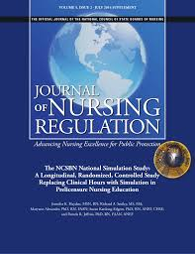
Background
July 2020 Summer Supplement
Free at ncsbn.org
Notes:
The results were published in July 2020, JNR, supplement. You might find them valuable when evaluating your programs.

Slide 4
Background
Results of comprehensive study reviewed by:
Regulators
Educators
Attorneys
Researchers
* At least 2 of the 4 national studies must have provided evidence for each Guideline.
Notes:
The results were reviewed by a panel of experts, including reps from AACN, NLN and OADN. Attorneys were included because each guideline was designed to be legally defensible. Each guideline had to have evidence from at least 2 of the studies in order to be included as a guideline.

Slide 5
Background
From these large, national studies, the first-ever core nursing education database was developed.
Only 52 core questions; BONs can add additional questions.
More than 20 BONs participated in the pilot year (2020-21).
Consistent data being collected.
Aggregate data will be statistically analyzed annually and publicly reported.
Notes:
From these studies, NCSBN developed this core nursing education annual report. By our participating with a number of other BONs by using this core data annual report, we are part of the first-ever core nursing education database! With only 52 core questions, this is not an obstacle for programs. Some BONs ask additional questions based on our regulations or workforce data needs, but many of our previous annual report questions are included in the core questions. From the annual report study that NCSBN had conducted, they found that the BONs did not collect the same data in the same way for the same time-periods, which of course is essential for research. This new core database will have consistent data so that more sophisticated statistical analyses can be done.

Slide 6
Survey
Your BON will send you the link.
You will have until June 30th to complete the survey.
We will remind you at the halfway mark.
Notes:
Our BON and not NCSBN will send you the link. (If the BON has a longer response time, just add here. ) NCSBN will send the programs a reminder if by the 15th of the month, or so, if they have not received your completed survey.

Slide 7
Survey
Any questions about the core data part of the survey go to NCSBN – contact email in the directions. (Qmcintosh@ncsbn.org)
NCSBN may contact you with questions as they clean the data.
Additional questions are KSBN required – contact KSBN for questions on these (Janelle.martin@ks.gov)
Notes:
Questions to Qiana Mcintosh (qmcintosh@ncsbn.org) at NCSBN. Sometimes mistakes are made when you are recording data (such as one program recorded they had 2.5 males; another recorded the average age of their students to be 1), so NCSBN will contact you if the data seem unlikely.

Slide 8
Directions
Complete the survey for each NCLEX code. (Bi-level programs should split numbers to represent each level.)
All questions are required.
You must each question in order to proceed
You may go back and make changes until the survey is submitted.
Your responses are automatically saved; when you return, use the same computer and browser.
Notes:
Here is what is in the directions: If you have two or more programs with NCLEX codes, please fill out a survey for both. Since these are core data, all questions must be answered. You cannot proceed until you answer the question you are on. You may go back and make changes until you submit. After you submit, NCSBN can open the survey for you to make changes; just contact qmcintosh@ncsbn.org. As you are answering the survey, your answers are automatically saved – however, you must use the same computer and browser when you return.

Slide 9
Screen shot of intro/directions:
Prelicensure Annual Report Core Data Survey
Introduction
In collaboration with your board of nursing (BON), NCSBN is assisting with collecting their Annual Report data this year. The survey was designed based on the core data results of a large, mixed-methods study of nursing program quality indicators and warning signs. NCSBN has included questions about COVID-19 to analyze its impact within your program. Your BON will include some additional questions at the end of the core survey.
Your BON will receive descriptive results of the nursing programs in their state/jurisdiction, as well as a report of the raw data of each program. Annually, they will receive an aggregate report of all participating BON’s so that they can compare their programs to the aggregate.
Directions
Please complete the following survey for each NCLEX code that you have. Since these are core data, all fields are required before you can proceed to the next question. We encourage you to compile the data on the pdf copy of the survey that the board will send you, and then you may enter your data into the online survey using the link provided. The survey saves your responses automatically. If you exit your survey, you may return to the pre-populated survey a long as you use the same computer/internet browser. Once you’ve responded to the last survey question, you will be shown a summary of your responses. You will have until June 30th to complete the survey, and we’ll send the results to your BON three weeks after the last program has submitted their survey. Remember, these questions are only for the programs with the NCLEX code that you have identified below. If you have any questions, please email Qiana McIntosh at NCSBN; her email is qmcintosh@ncsbn.org.
Notes:
Here is a screen shot of intro/directions. Just a couple of side notes to these directions: 1) KSBN will have added questions after the Core data an COVID-19 questions are complete. These are required questions as well per KNPA regulation or USDOE requirements. 2) NCLEX codes are only for undergraduate nursing programs . For those with graduate (APRN) programs, there will be a section at the end of the KSBN UG section for Graduate programs to complete. These are KSBN questions only and will not be reported by NCSBN in the aggregate data. All data for graduate programs will go back to KSBN for review and compilation. 3) Programs will have until June 30th to complete the surveys (even if directions say 30 days).

Slide 10
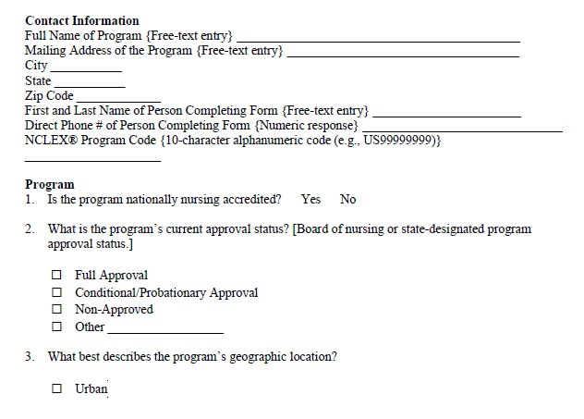
Full name should include program type – PN, ADN, BSN for easy identification.
Question 1 is about national accreditation..
Question 2 is about approval from KSBN. Please answer accordingly.
Notes:
Here is an example of what questions will look like when you receive it.

Slide 11
Additional Questions - KSBN
There are 3 sections of questions:
1. CORE ?’s,
2. COVID ?’s
3. KSBN ?’s
Notes:
Here is an example of what questions will look like when you reach the KSBN section. (after CORE and COVID-19 questions)

Slide 12
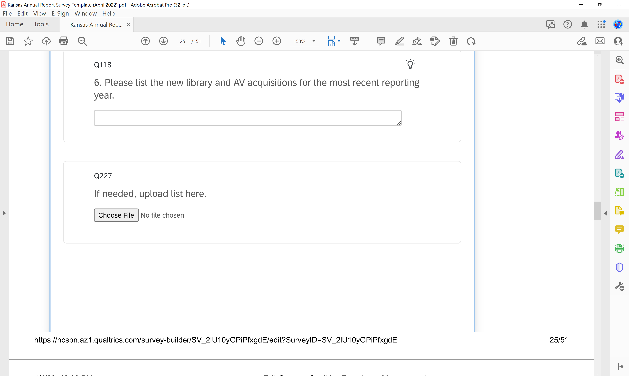
Additional Questions - KSBN
Some questions have a place to upload a list if you wish – it is not required.
Notes:
Some of the KSBN questions may / will require an attachment. If you go to the “Choose File” button, you can upload a list of your own..

Slide 13
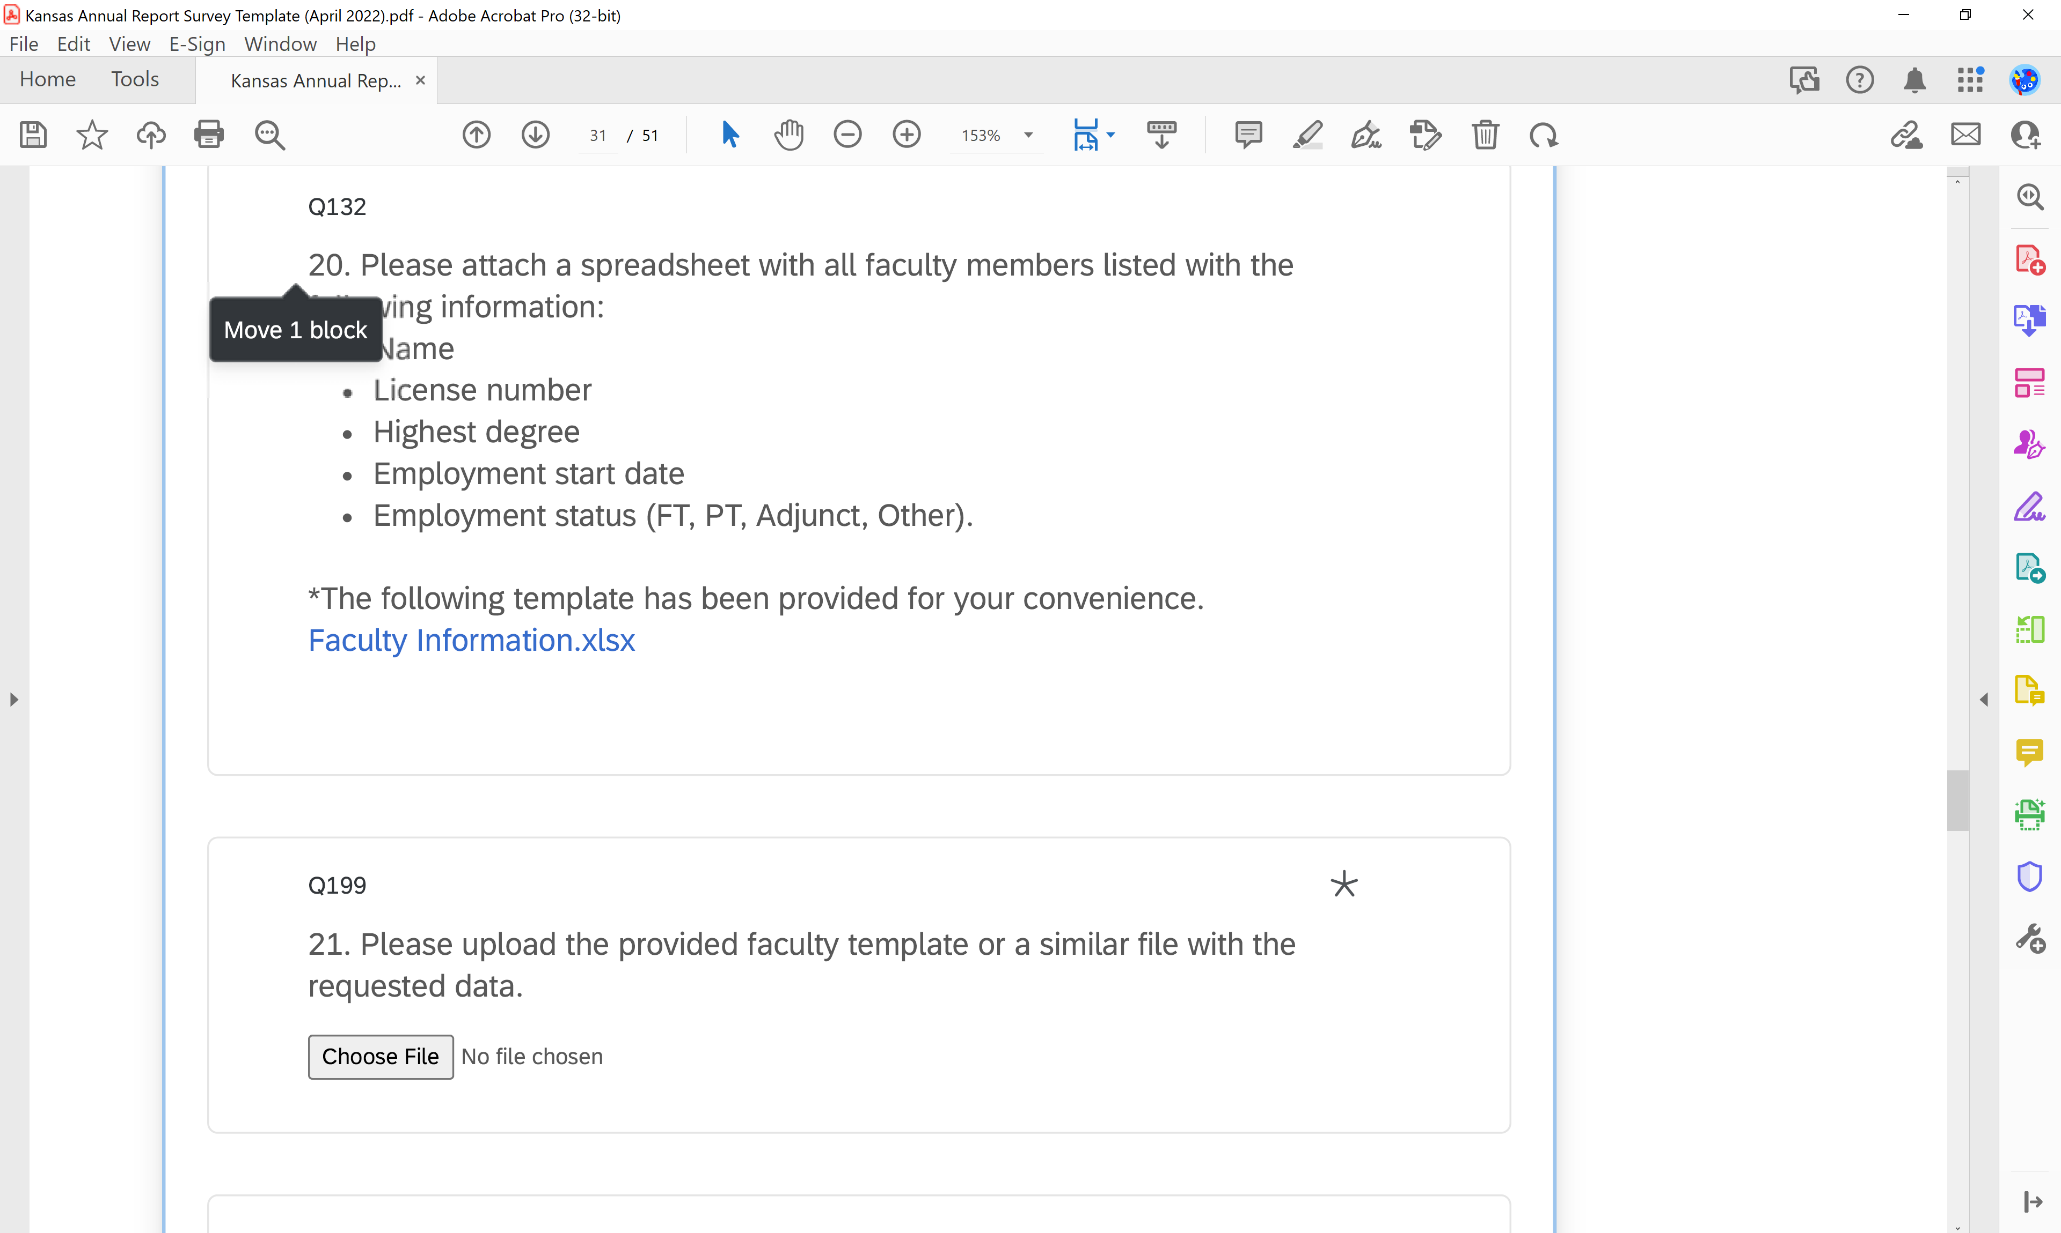
Additional Questions - KSBN
Four of the questions will require an attachment.
If you would like to use the KSBN template, it is provided for you.
IT IS NOT REQUIRED!
Whatever attachment you use can be attached when you see the “Choose File” button
Notes:
Some of the KSBN questions will require an attachment. These are four questions where lists are needed….faculty, nursing courses, facilities, preceptors. There are Excel templates for these lists if you choose to use them – IT IS NOT REQUIRED. If you already have documents with the required information included, you may use that document and attach.

Slide 14
Graduate Section
Graduate programs will have to complete their section once the UG program data is entered (due to survey requirements for mandatory questions).
IF YOU HAVE A GRADUATE PROGRAM – DO NOT SUBMIT AT THE END OF THE UG SECTION. Save your work, answer “Yes” to the question “Do you have a graduate program?” and forward to the person who will answer the graduate program questions.
Same directions apply to the graduate section – you may save and return to the survey using the same computer/internet browser. DO NOT submit until all questions have been completed.
Save a copy of your submission prior to submitting.
Notes:
Here is an example of what it will look like at the end of the undergraduate section where the Graduate Program survey questions begin.

Slide 15
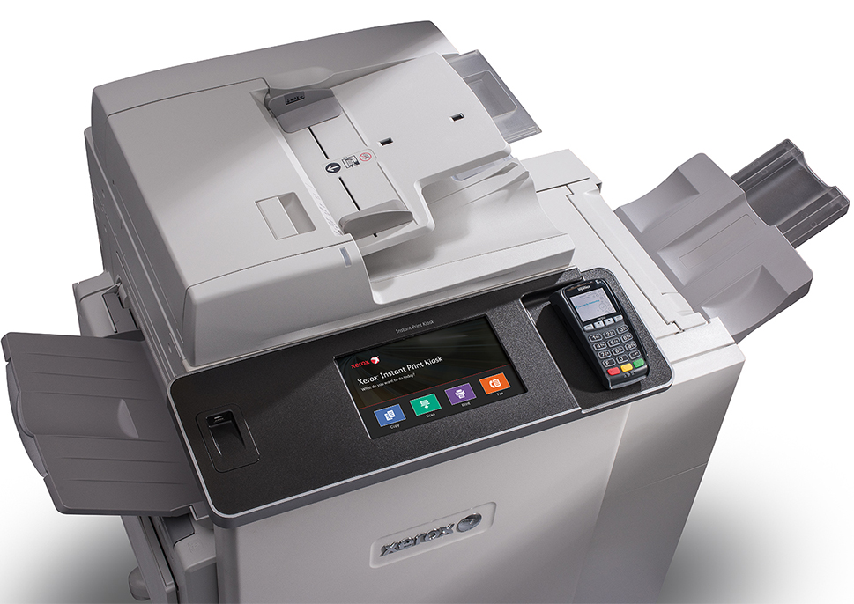
Submitting the Survey
After the last question, you’ll have a summary of
your responses. (see next slide)
You can then download your report before
submitting. Please Save a copy of your report before submitting!
Click the “blue arrow” on the right of the progression bar– and you are finished!
Notes:
You can see how you’ve answered the questions and download your report before you actually submit it. Next, we will show you some screen shots of downloading your report and then submitting your survey.

Slide 16
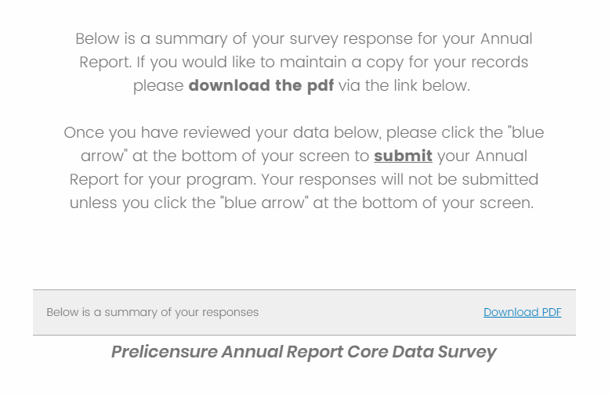
Notes:
Here is where it tells you to review a summary of your responses and then to download the pdf for your files.

Slide 17
At the bottom of the “survey summary page” you will see two blue arrows. In order for your Annual Report to be submitted, you must click the Blue arrow on the right.
This is the SUBMIT button!
Notes:
And here is where you’ll click the arrow on the lower right to submit!

Slide 18
This is a Win-Win Situation
Not only will you be able to complete your annual reports for your BON - but you will be a part of the first-ever nursing education database!
Notes:
You will be a part of a big national nursing education database as you answer our BON’s annual report questions! This is exciting!

Slide 19
Questions????

